Slide 1
Development Phase
Besfort Avdyli
https://github.com/Besfort21/Flask_Todo_List

Slide 2
Purpose of the web app
A list of tasks you need to complete or things that you want to do.
Helps the user stay organized.
Make the Tasks seem more managable.
Less likely to forget tasks.
Clarify Goals.

Slide 3
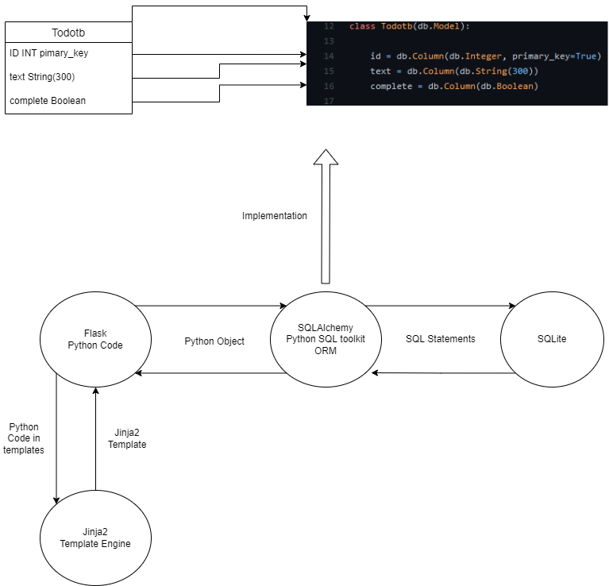
Architecture diagram

Slide 4
Technology choices
Backend: Python, Flask, Flask-SQLAlchemy, SQLAlchemy, SQLite
->Flask is a micro web framework. Collection of libraries and modules that enable web application developers to write applications.
->Flask-SQLAlchemy is a Flask extension that adds support for SQLAlchemy to the Flask application.
->SQLAlchemy is the Python SQL toolkit and ORM.
Frontend: HTML, CSS, JavaScript
Template Engine: Jinja2
->Jinja2 is a template language for Python. It is used to create HTML,XML or other markup formats that are returned to the user via an HTTP request.

Slide 5
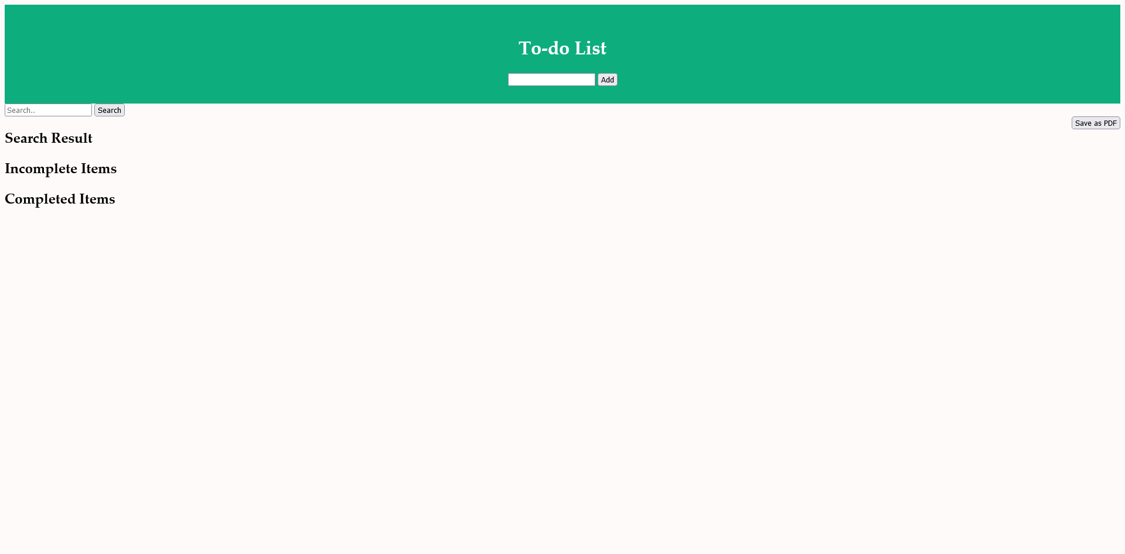
Screenshots
Main Page without To-do Entries.
One text field for adding to-do items.
One Search field filtering existing to-do items.
One button for saving the to-do list as a
PDF

Slide 6
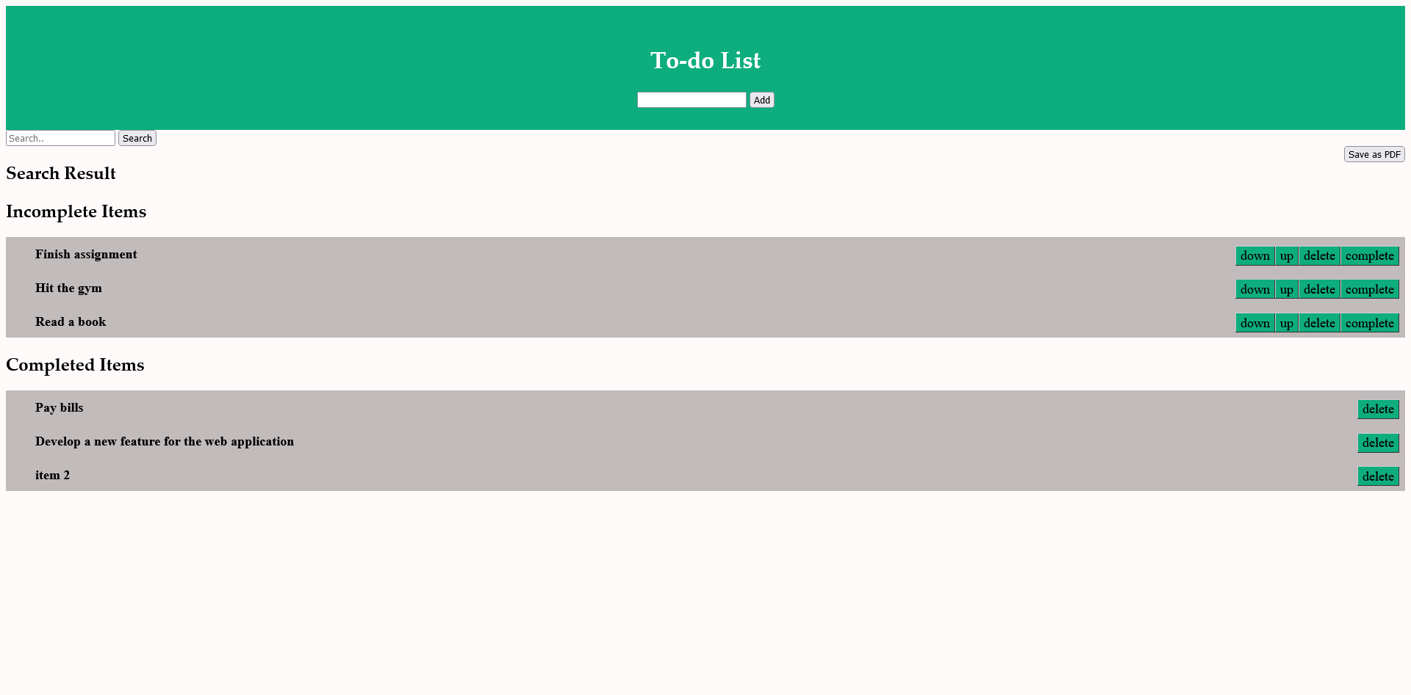
Screenshots
Main Page with some to-do examples.
Incomplete and Complete items separate.
Buttons for marking items as complete ,deleting or moving items up and down.

Slide 7
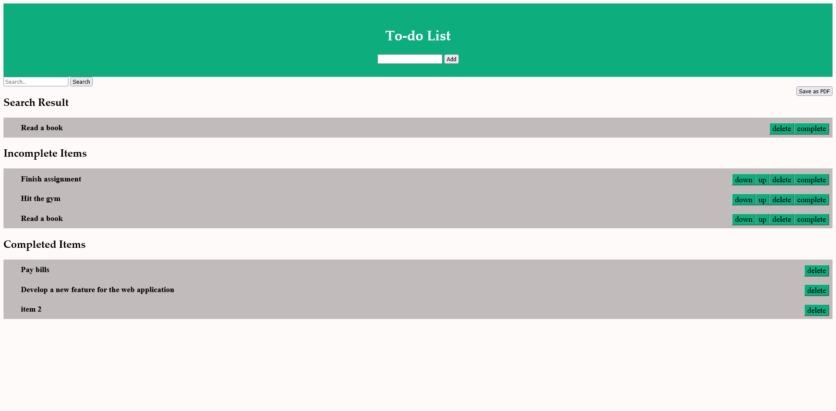
Screenshots
Main Page with Search Result.

Slide 8
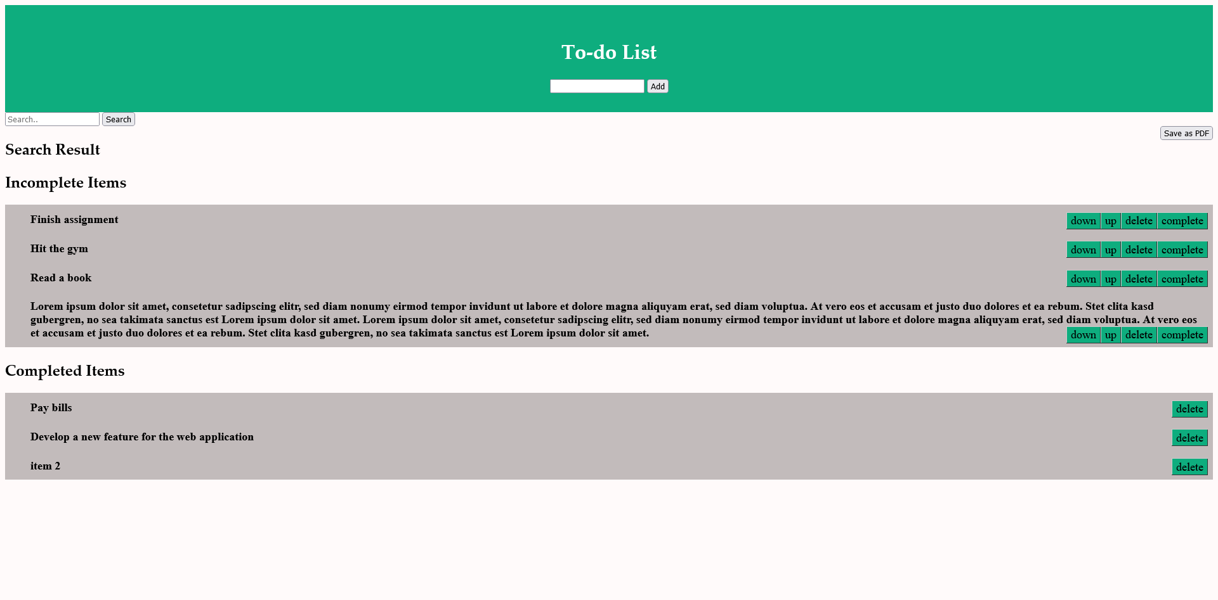
Screenshots
Main Page with very long todo list item.

Slide 9
Changes compared to Phase 1
At first it was planned to realize the search/filter function in the frontend with JavaScript. However, this approach turned out to be difficult since this was quite difficult to implement only in JavaScript and the conflict with probably Jinja since the individual list entries were somehow not referenceable to enable the search functionality. Therefore, I decided to realize this in the backend with Python.
New additional Feature:
->Save the to-do list as a PDF.

Slide 10
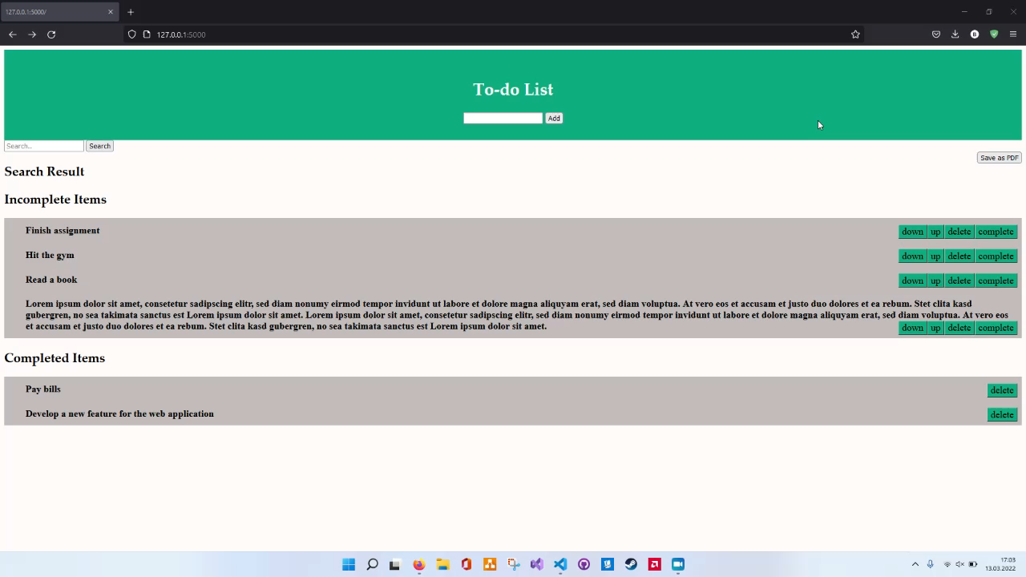
Screencast

